Slide 1
CLASS 5 – 11.23.2021
Player Analytics II – Soccer Analytics
Assignment #3 – Due Nov. 28 | Individual
Final – Due Dec. 11 | Group
Guest Speaker:
Momin Ghaffar
Director of Strategic Research & Development,
Jacksonville Jaguars
Breaks: 5:30pm (5 mins) | 6:05pm (10 mins)

Slide 2
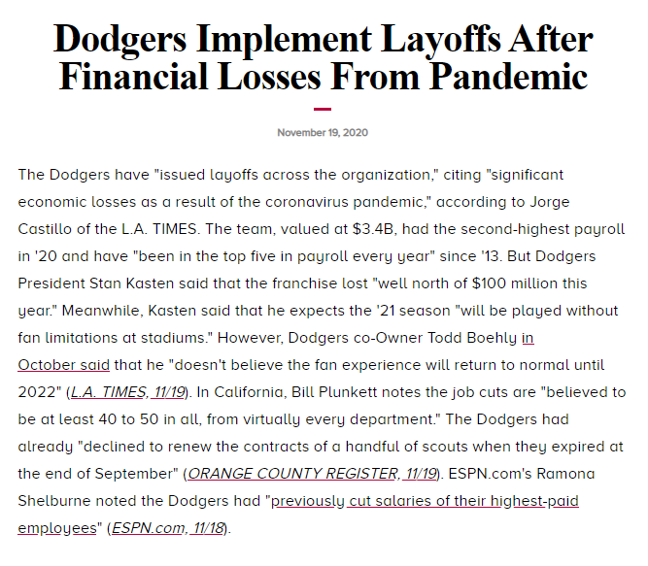
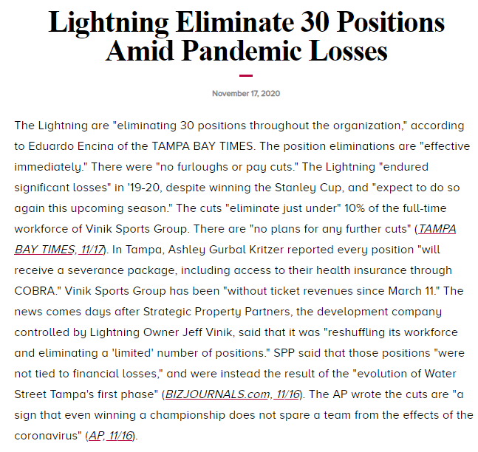
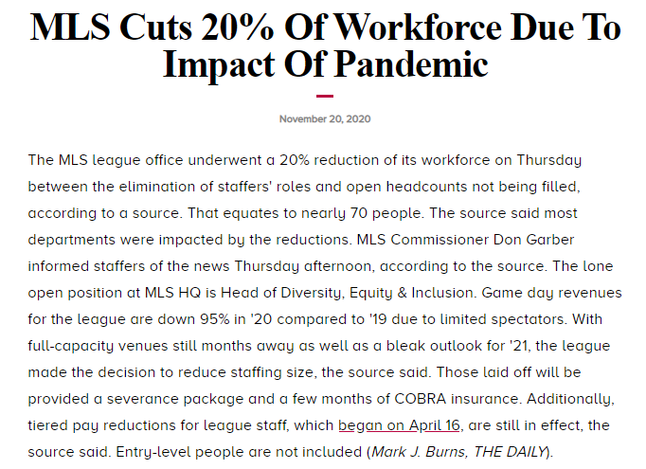
A year ago at this time

Slide 3
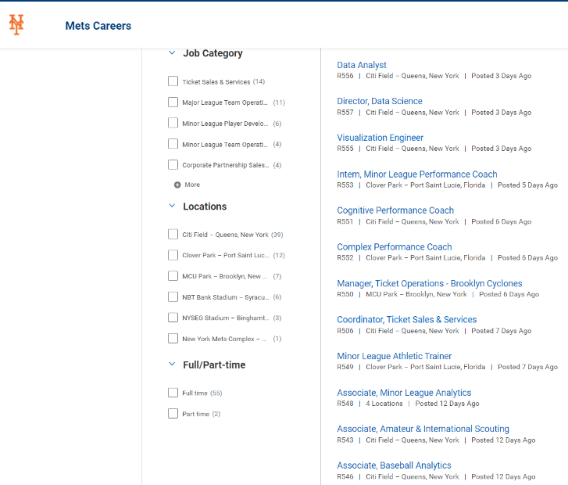

This year
https://sterlingmets.wd5.myworkdayjobs.com/Mets
Notes:
https://sterlingmets.wd5.myworkdayjobs.com/Mets

Slide 4
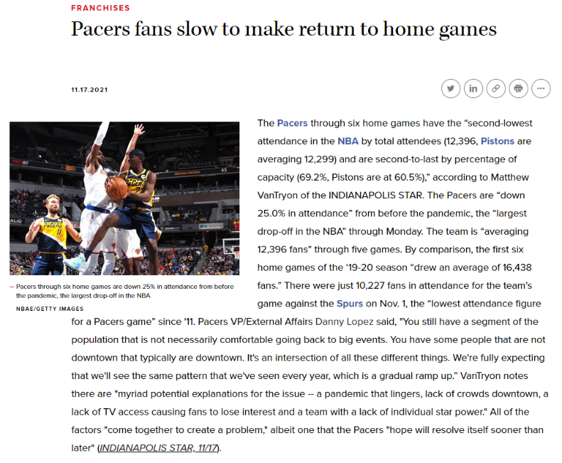
Sports Analytics trends – past week

Slide 5
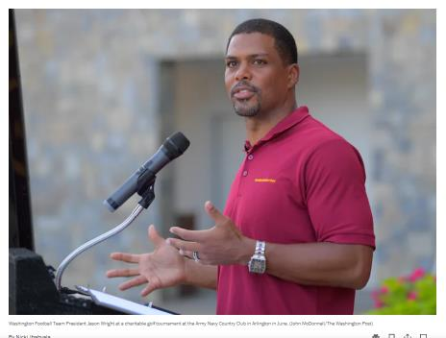
Washington Football Team President Jason Wright says fan attendance at FedEx Field is not actually down but rather the team is more accurately reporting it this season.
In a recent conversation with The Washington Post, Wright described the team’s NFL-low attendance average as a public narrative that is “not a good one." But he alleged “it’s actually been there for some time.”
Wright, in a subsequent interview with 106.7 the Fan on Friday, described the Washington Football Team as “a healthy organization now,” adding: “We’re doing incredibly well on the inside, and it’s starting to show in our performance.”
A team spokesperson later clarified to The Post that Wright was referring to the organization’s culture. On the field, the team is 3-6.
Notes:
https://www.washingtonpost.com/sports/2021/11/19/washington-football-team-jason-wright-attendance-culture/

Slide 6
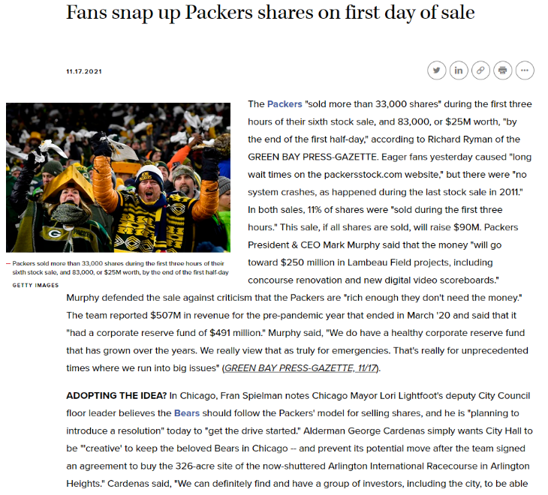

Slide 7
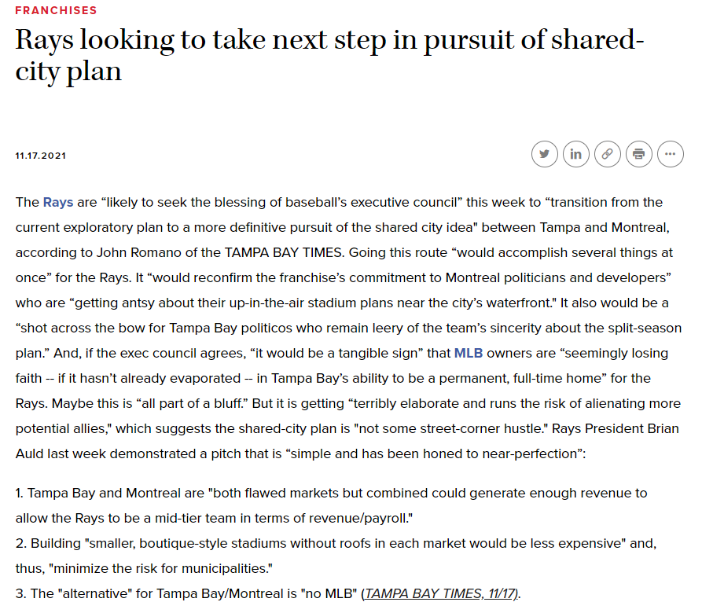
The Rays were one of only three teams to average fewer than 10,000 fans at home games in 2021, despite winning more regular-season games than all but two teams and making it to the World Series the previous year.

Slide 8
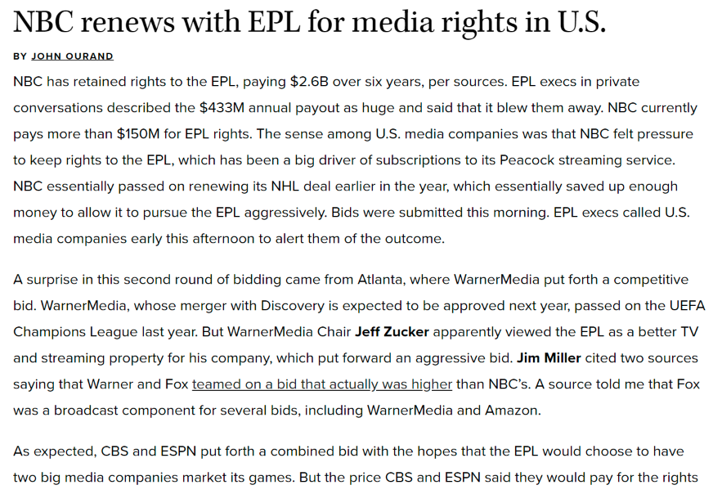

Slide 9
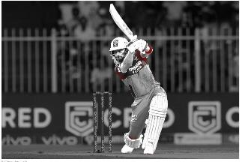
The Indian Premier League is currently receiving more global attention than it ever has — and with two new teams joining the league, TV rights will likely become a tug-of-war.
Disney-owned Star India’s $2.6 billion, five-year deal for IPL broadcasting rights expires next year — the same year the league expands from eight to 10 teams — and the cost is estimated to increase by at least 25%.
The most recent price tag for IPL rights nearly quadrupled from what Sony paid to broadcast the first 10 years of the league in 2008. Sony may bid for the rights again this round, along with Zee Entertainment, in which Sony plans to purchase a 53% stake.
The league has been at the center of several major deals this year.
CVC Capital Partners, which owns stakes in La Liga, paid around $736 million for the new Ahmedabad franchise.
RPSG, a conglomerate owned by Sanjiv Goenka, shelled out roughly $964 million for the new Lucknow team.
In June, RedBird Capital acquired a 15% stake in IPL’s Rajasthan Royals for around $37.5 million, valuing the team at $250 million.
Last season, 31.57 million people watched the league’s final. In the past few seasons, Star India says that at least 400 million people have watched at least one match.
The IPL was reportedly valued at $6.2 billion in 2020.

Slide 10
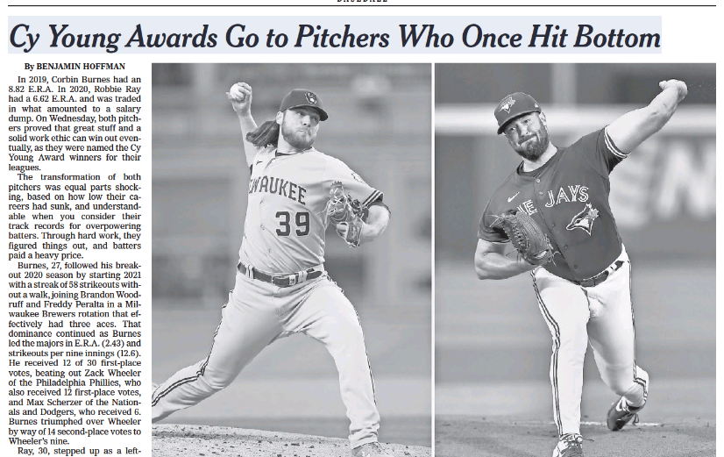
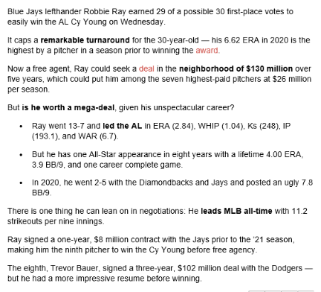

Slide 11
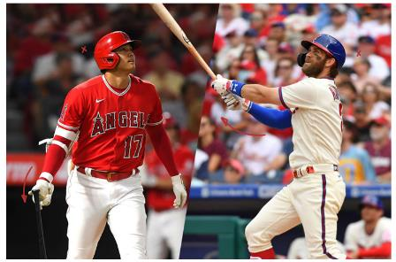
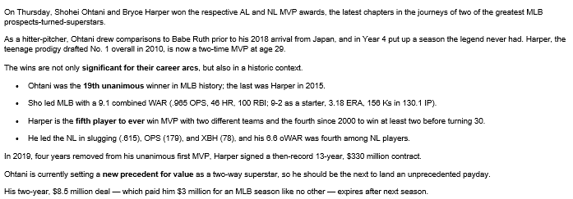

Slide 12
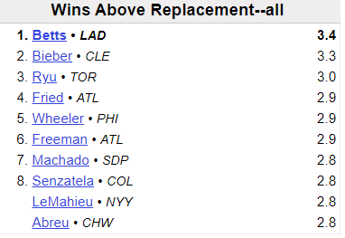
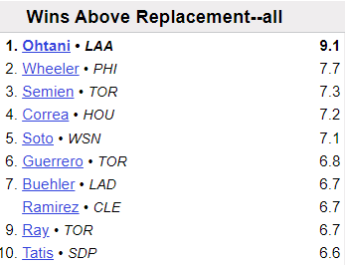
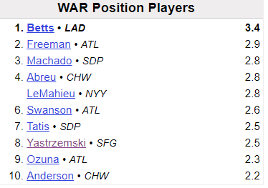
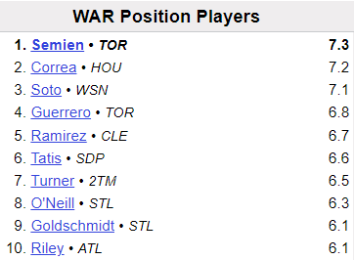
2019/2021 WAR leaders
= MVP
2020
2021 {MVPs – Thur 11/18}
Notes:
https://www.baseball-reference.com/leagues/majors/2021-batting-leaders.shtml

Slide 13
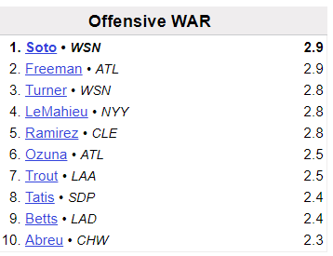
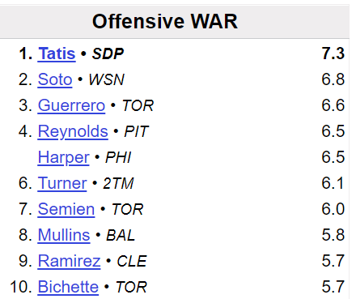
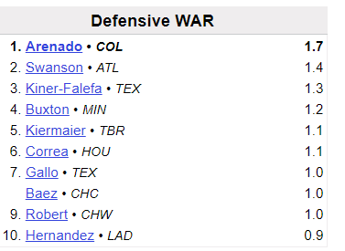
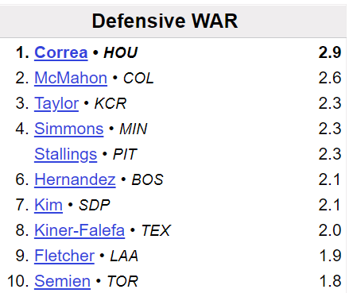
2019-20 WAR leaders: Offense vs. Defense
= MVP
2020
2021
Notes:
http://www.baseball-reference.com/leagues/MLB/2018-batting-leaders.shtml

Slide 14
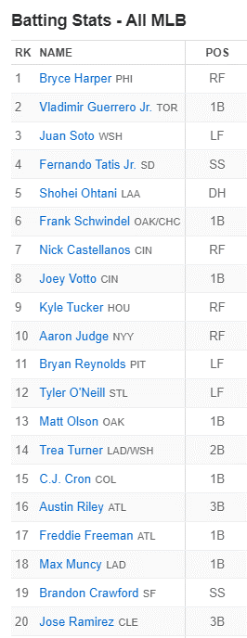
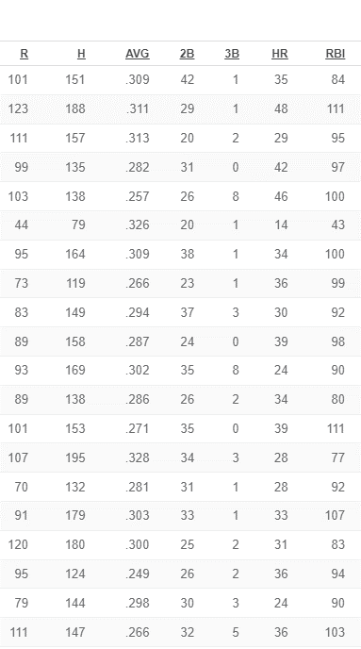
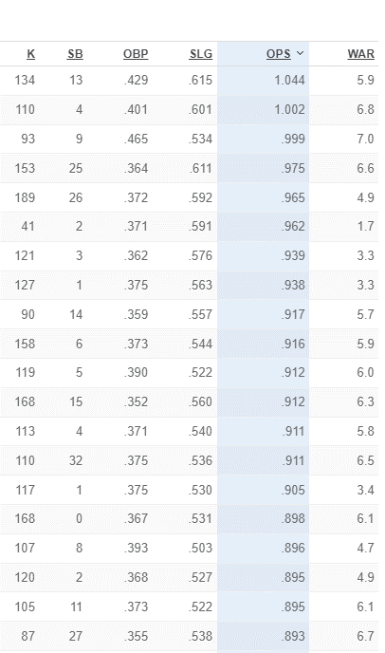
OPS: TOP 20 in 2021
{1}
{18}
{11}
{2}
{5}

Slide 15
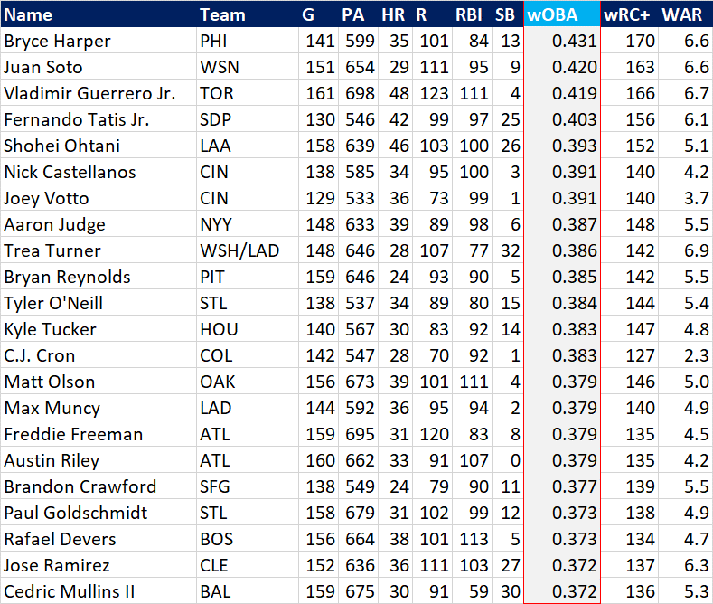
2021 wOBA leaders

Slide 16
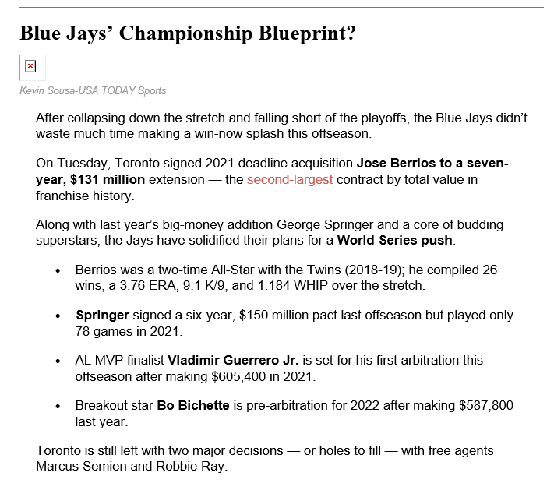

Slide 17
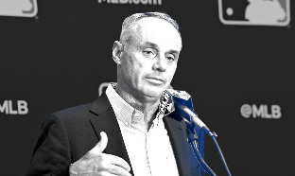
Major League Baseball could be headed for a lockout, as labor negotiations between the league and its players association are progressing slowly.
MLB commissioner Rob Manfred said that the Dec. 1 expiration of the current collective bargaining agreement is not a hard deadline for agreeing to a new CBA.
“I can’t believe there’s a single fan in the world who doesn’t understand that an offseason lockout that moves the process forward is different than a labor dispute that costs games,” Manfred said on Thursday.
A lockout would put a hold on all MLB transactions.
The league is not required to initiate a lockout after the CBA expires but may choose to do so.
The MLB free-agent market has been robust thus far, particularly for starting pitchers. Justin Verlander and Noah Syndergaard — two aces coming off Tommy John surgery — signed one-year deals for $25 million and $21 million, respectively.
As many as 12 free agents are predicted to land contracts worth $100 million or more.
Should the two sides fail to reach an agreement before the season is set to start in March, MLB could face a shortened or even canceled season.
The league suffered around $3 billion in operational losses in 2020, due to a shortened season played mostly in empty stadiums.

Slide 18
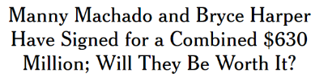
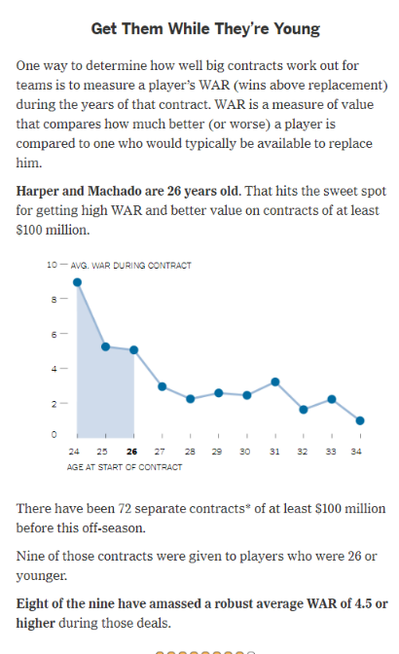
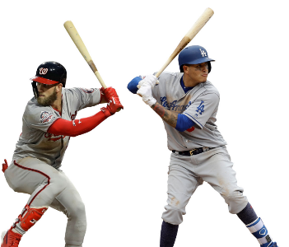
Notes:
https://www.nytimes.com/interactive/2019/02/20/sports/baseball/free-agent-big-contracts.html

Slide 19
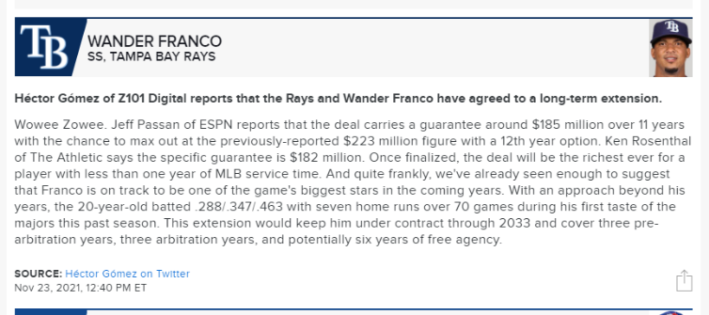
Franco signed an 11-year contract worth $182 million guaranteed with a club option for a 12th season, per Jeff Passan. The maximum value of the deal is $223 million.
MLB’s 2020 No. 1 prospect is only 20, with 70 games and 308 at-bats to his name, but the early returns indicate this could be the steal of the decade.
His 3.5 single season WAR was the sixth-highest for a player with 70 games or fewer since 1990.
He reached base in 43 consecutive games, tied with Frank Robinson for the most in MLB history for a player under 21.
He finished third in AL Rookie of the Year voting behind teammate Randy Arozarena and Houston’s Luis Garcia.
Tuesday’s blockbuster is also the largest contract for a player under 21 in MLB history, but the bargain lies in the $16.5 million AAV, which is only 62nd in the league — and the fact that the guaranteed total value of $182 million ranks 20th in MLB.

Slide 20
Player Analytics
11/16 – Baseball |
11/23 – Soccer | Momin Ghaffar, Jaguars
11/30 – Basketball | Kevin Tenenbaum, Cle MLB
12/7 – Hockey | Oliver Miller-Farrell, Nash SC
KEY TAKEAWAYS:
How has the sport evolved: Basic vs. Advanced Stats
Offense vs. Defense
End-all Be-all | One all encompassing stat? WAR

Slide 21
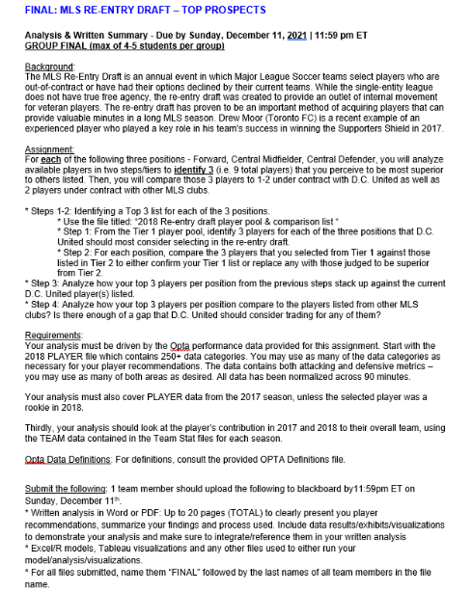
Final (Group) – Due 12/11

Slide 22
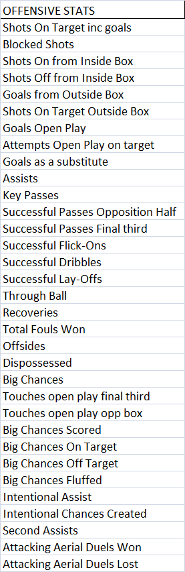
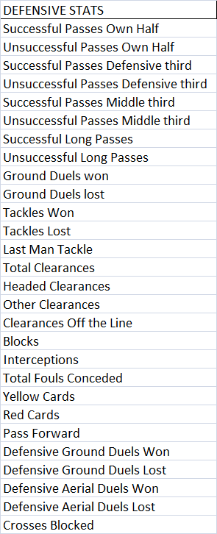
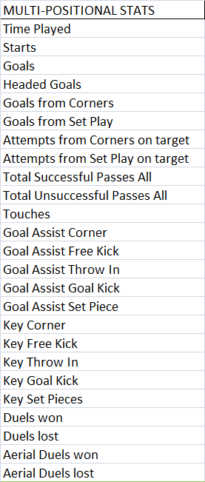
ADVANCED PLAYERS DATA – OPTA – 255 CATEGORIES

Slide 23
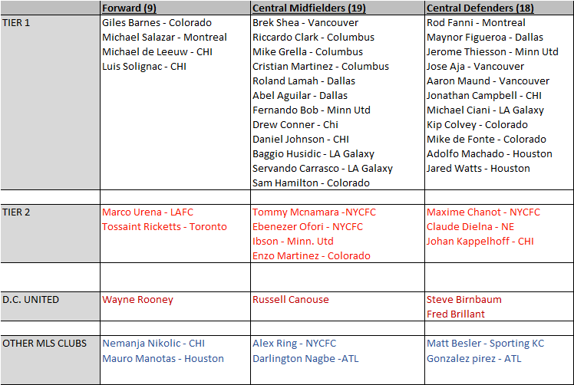
CLASS FINAL – PLAYER POOL COMPARISON LIST

Slide 24
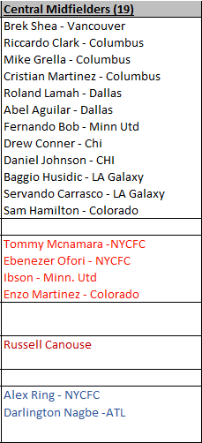
CLASS FINAL – CENTRAL MIDFIELDERS

Slide 25
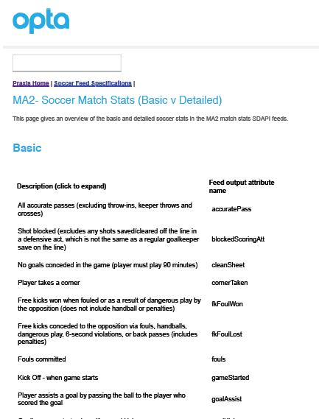

Slide 26





Finding the all-encompassing stat
Wins Above Replacement (WAR)
Player Efficiency Ratio (PER)
Audi Player Index – For Fans Only
Corsi/Fenwick
Total Quarterback Rating (TQR)

Slide 27
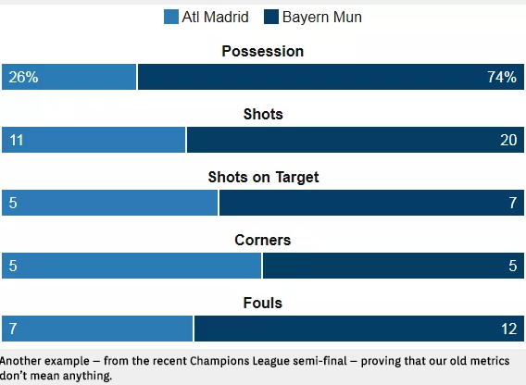
Traditional Match Stats
Atletico 1 | Bayern 0
- Leg 1 4.27.16

Slide 28
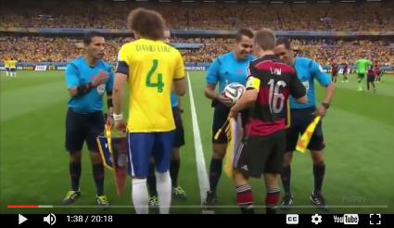
Team A: 52% possession; total shots 18; corner kicks 7
Team B: 48% possession; total shots 14; corner kicks 5
Close Game??
https://www.youtube.com/watch?v=a7IMPsyQg6k
Notes:
https://www.youtube.com/watch?v=a7IMPsyQg6k
Well, Team A was Brazil and Team B was Germany in the 2014 World Cup semifinal. Germany advanced, thanks to a historic 7:1 victory. Yet according to the stats, looks like it was a close one.
https://www.youtube.com/watch?v=-sfRVyDHT30

Slide 29
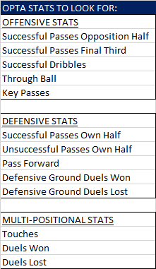
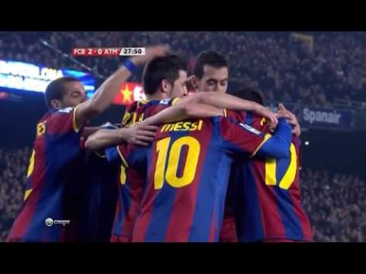
FC Barcelona possession
Notes:
https://www.youtube.com/watch?v=VWKPSulCcWI

Slide 30
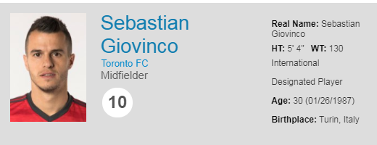
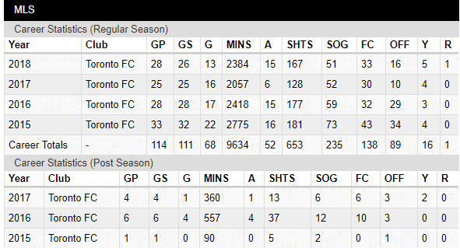
Traditional Player Stats (2017)
Guaranteed Comp:
$7.1M
Notes:
http://www.mlssoccer.com/players/sebastian-giovinco
https://mlsplayers.org/salary-guide/

Slide 31
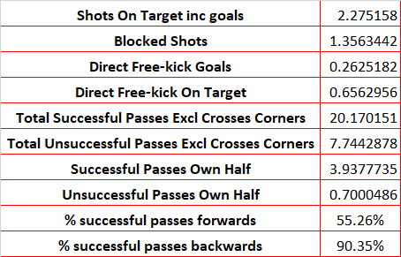
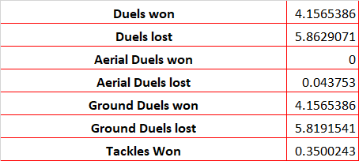
Advanced Stats: Giovinco – Per 90 Minutes (2017)

Slide 32
Stats comparison - 2020
MLS basic stats - https://www.mlssoccer.com/stats
MLS advanced stats - https://www.mlssoccer.com/post/2020/09/21/2020-mls-advanced-stats-leaders
Who Scored – Player stats
https://www.whoscored.com/Regions/252/Tournaments/2/Seasons/8228/Stages/18685/PlayerStatistics/England-Premier-League-2020-2021

Slide 33
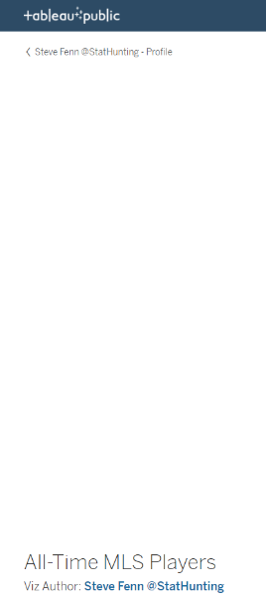
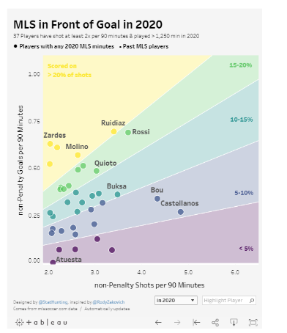
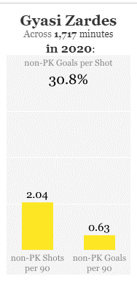
https://public.tableau.com/profile/fennsk#!/vizhome/All-TimeMLSPlayers/ScoringShotsvsGoals
Notes:
https://public.tableau.com/profile/fennsk#!/vizhome/All-TimeMLSPlayers/ScoringShotsvsGoals

Slide 34

https://public.tableau.com/profile/fennsk#!/vizhome/MLS2019GoalScoringOpportunities_15890942796780/Profilingdirectscoringcontributors
Notes:
https://public.tableau.com/profile/fennsk#!/vizhome/MLS2019GoalScoringOpportunities_15890942796780/Profilingdirectscoringcontributors

Slide 35

Soccer Player Ratings – 1-10 Scale
Most graders begin from the same place, starting each player with a 5 (or a 6, if they are generous) before adjusting up or down during a game. A player who does not make much of an impact, but does little wrong, most likely stays in the middle. A catastrophic mistake that leads to a goal can drop a defender to a low mark, like a 3, even if the other 89 minutes of the player’s performance were decent. Likewise, scoring a goal can elevate a forward’s pedestrian day to a 7 or an 8.
At L’Equipe, the signature news media outlet of these Euros, as many as six journalists will give their marks for the French national team after each of its games. The paper’s so-called official ratings will be an average of these scores.
Notes:
http://www.nytimes.com/2016/06/14/sports/soccer/euro-2016-player-ratings.html?_r=0
In general, perfect 10s are rare (as are zeros). Duluc said, somewhat proudly, that 10 players received a 1 during the recently completed French league season, and that he had handed out three of them. Rodríguez said the last perfect score he gave was to Barcelona’s Lionel Messi when he scored four goals against Arsenal in the 2013 Champions League, and Duluc added that he believed that game was the last time any player received a 10 in L’Equipe as well.

Slide 36

Costa Rica (4) v. USA (0) – World Cup Qualifier – 11.15.16
Brad Guzan (5.5) Timothy Chandler (4.5) Omar Gonzalez (4.5)
John Brooks (1) - Though the Hertha Berlin was bailed out by Guzan in the 18th minute, his flub would stand as a bad omen. To put it mildly, this was a nightmare showing for Brooks. He was to blame on all four Ticos' goals, and in varying ways. He lost an aerial mark, mishandled, was nutmegged – you name it, he suffered it.
Matt Besler (4.5) Michael Bradley (5) Jermaine Jones (4.5)
Fabian Johnson (4.5) Christian Pulisic (5.5) Bobby Wood (5) .
Jozy Altidore (5) -
Coach Jurgen Klinsmann (4.5) - The boss was less overtly to blame tactically than against Mexico, but that's faint praise after a miserable start to the Hexagonal. He should have a clear idea on how to get the best out of his group by now, but he is forever searching and this can't help but have a negative effect. Honestly, this game should have been set up for a happy surprise; he wanted an "angry" USMNT, but we got dreariness instead.
Subs:
Lynden Gooch (6) Graham Zusi (6)
Notes:
http://www.mlssoccer.com/post/2016/11/16/usmnt-ratings-how-low-can-us-go-vs-costa-rica-quite-low-indeed

Slide 37

Audi Player Index
Notes:
http://www.mlssoccer.com/audi/faq

Slide 38




Audi Player Index – Forwards – For Fans Only
2017
2016
2017
2016
Notes:
http://www.mlssoccer.com/audi/scoring/forward

Slide 39

Audi Player Index - All
2019 Regular Season
Final Standings
Eligibility:
24 games played
70% of matches
1,530 minutes
FWD
FWD
FWD
MD
FWD
FWD
MD
MD
MD
MD
MD
FWD
MD
GK
MD
Notes:
http://www.mlssoccer.com/audi/audi-player-index-award
mU

Slide 40

Advanced Stats – Creating Chances
DZS: Shots from the danger zone, which is zones 1-3, the close and central areas of the box.
WS: Shots from the wide areas of the 18-yard-box, zones 4-5.
SoB: Shots from outside the 18-yard-box, zones 6-8.
%Cross: Percentage of shots from the danger zone assisted by crosses.
%TB: Percentage of shots from zones 1-5 assisted by through-balls.
SoT: Shots on target
DZ Pass: Shots assisted by passes in or around the danger zone.
Counter: Shots attempted from counterattacking moves
Est. Poss.: Shot attempted from established possession in the opposition half
NPG: Goals not from penalties or from own goals. (xG is meant to nearly sum to NPG, but it does not quite because (a) the fit isn't exactly perfect and (b) xG deprecates shots off rebounds and only counts for a team one shot from every attacking move.)
TSD: Total Shots Difference, shots taken minus shots allowed.
SoTD: Shots on target difference, shots on target minus shots on target conceded.
xG: Expected goals scored or conceded based on shot type, assist type and shot location, speed of attack and a few more factors. For the explanation of the components of xG, see my full open-method expected goals methodology.
Expected goals here does not sum to the same total as goals, because it excludes penalties and own goals, as well as deprecating the value of chances off rebounds
Notes:
https://www.sbnation.com/soccer/2014/3/7/5481326/mls-advanced-statistics#glossary
https://cartilagefreecaptain.sbnation.com/2014/2/12/5404348/english-premier-league-shot-statistics

Slide 41

English Premiership 2015-2016 – Advanced Shooting Stats
Notes:
https://www.sbnation.com/soccer/2014/3/7/5481326/mls-advanced-statistics#glossary
https://cartilagefreecaptain.sbnation.com/2014/2/12/5404348/english-premier-league-shot-statistics

Slide 42

English Premiership 2015-2016 – Advanced Defensive Stats
Notes:
https://www.sbnation.com/soccer/2014/3/7/5481326/mls-advanced-statistics#glossary
https://cartilagefreecaptain.sbnation.com/2014/2/12/5404348/english-premier-league-shot-statistics

Slide 43

English Premiership 2015-2016 – Advanced Defensive Stats
NPG: Goals Not from Penalties
Notes:
https://www.sbnation.com/soccer/2014/3/7/5481326/mls-advanced-statistics#glossary
https://cartilagefreecaptain.sbnation.com/2014/2/12/5404348/english-premier-league-shot-statistics

Slide 44



Measuring Pressure – Attacking/Pressing the Opponent
PPDA: Passes Per Defensive Action
= Number of Passes made by Attacking Team / Number of Defensive Actions
The defensive actions are the following four Opta defined events:
* Tackles
* Interceptions
*Challenges (failed tackles)
*Fouls
Notes:
http://statsbomb.com/2014/07/defensive-metrics-measuring-the-intensity-of-a-high-press/
http://www.optasportspro.com/en/about/optapro-blog/posts/2016/blog-how-we-measure-pressure/

Slide 45


PACKING
New way to value the passer
The methodology behind packing is fairly easy to understand. Essentially, players earn a point for any move — a cross, a dribble, a long pass — that causes the ball to move past opposition players. If a move begins with five opponents between the ball and the goal, and ends with two, that’s three points. The receiver of the pass is awarded points as well.
An athlete who feels he is underappreciated can sulk, sound off to the media, or go on a Twitter rant. Or he can invent a new statistic that proves his worth.
That’s what two defensive midfielders did, and now their invention is the talk of soccer’s statistics world. Stefan Reinartz and Jens Hegeler were defensive midfielders in the Bundesliga in 2015 when they created the metric known as packing.
Notes:
https://www.nytimes.com/2018/09/20/sports/soccer/packing-statistic-toni-kroos.html

Slide 46


Packing – EPL - 2018
Notes:
https://twitter.com/impect_official?lang=en

Slide 47


Packing – La Liga
Notes:
https://twitter.com/impect_official?lang=en

Slide 48


Relies on analytics over scouting due to low budget
Aims to sign players 23 or younger. Only 2 players 25+ yrs old
Strategy: High-press/relentless attack.
no focus on possession – ranked 17th out of 24 teams. Instead looks to force turnovers in the offensive third and capitalize on opponents mistakes. Only bring in players that are physically fit to place this style; most teams do not
Imported Daryl Dike (age 20) midseason and moved from 12th place up to 5th 19 games later
Notes:
Barnsley FC – 2nd lowest payroll in Championship in 2020-21. Imported Daryl Dike from Orlando City SC to try and make the playoffs. Missed by 2 pts.
https://www.sportico.com/leagues/soccer/2021/barnsley-premier-league-promotion-1234628851/

Slide 49

ProZone
https://www.youtube.com/watch?v=RV9Mo-2POWo
Notes:
https://www.youtube.com/watch?v=RV9Mo-2POWo

Slide 50



WhoScored.com
Notes:
https://www.whoscored.com/Matches/1190315/Live/England-Premier-League-2017-2018-Arsenal-Manchester-United

Slide 51


https://www.whoscored.com/Matches/1485307/Live/England-Premier-League-2020-2021-Tottenham-Manchester-City
Notes:
https://www.whoscored.com/Matches/1485307/Live/England-Premier-League-2020-2021-Tottenham-Manchester-City
Match Center – show heat maps, Arsenal midfielders.
Match Report – Situational Report (Attempt Types, Pass Types)
Positional Report – Shot Zones (ties back to earlier stats)

Slide 52

https://www.whoscored.com/Statistics
Notes:
https://www.whoscored.com/Statistics -Show both Team Stats breakdowns and Player Stats breakdowns

Slide 53


https://www.whoscored.com/Regions/233/Tournaments/85/USA-Major-League-Soccer
Notes:
https://www.whoscored.com/Regions/233/Tournaments/85/USA-Major-League-Soccer

Slide 54



Ray Hudson on Stats
Player:
Newcastle United
TB Rowdies
Coach:
Miami Fusion
D.C. United.
https://www.beinsports.com/us/laliga/video/messi-gives-barcelona-late-lead-over-atletico/1359444
Notes:
https://www.beinsports.com/us/laliga/video/messi-gives-barcelona-late-lead-over-atletico/1359444

Slide 55

Case Study:
Nashville SC
Building an expansion team
“I take a lot of pride in the potential of us being the Moneyball story of Major League Soccer.”
“I say that very proudly. I was teased sometimes in Kansas City for being a Moneyball theorist. Moneyball is not just about stats, or about mathematicians sitting in a cubicle committed to formulas. What Moneyball is, in the simplest of terms, is acquiring the undervalued and discarding the overvalued.”
- GM Mike Jacobs

Slide 56


Slide 57

Notes:
https://twitter.com/benwright/status/1325843827656171525/photo/1

Slide 58

0.96 GAA – best of any expansion team in MLS history
Notes:
https://twitter.com/benwright/status/1325843827656171525/photo/2
NSC: 23 games | 24 GF, 22 GA

Slide 59




Jacobs said his staff made sure to watch every single match played in MLS during the 2019 season, either on film or in-person, to find the best players that could be available during the Expansion Draft or available via trade.
“We’ve been prepping ourselves for months about the players we think best fit our roster, either players we thought would be unprotected or players we might be able to trade for by selecting a pick,” Jacobs said. “Starting Friday night, we’re matching up either players that we’re looking for ourselves or players that other teams want to acquire. We’re trying to see which players are most valuable. Because that value is not just who we think we can get for our team, but it’s who we think we can acquire and trade to somebody else for more value. The Expansion Draft for us is all about acquiring as much value as we can in drafting players, drafting players for other teams and acquiring assets to get future players.”
11/20: 9 played/7 starters
Jacobs is firmly on board with the value of analytics across multiple areas of operations.
“We're not just doing this because other clubs are doing it – maybe we're doing some things other clubs aren't doing, in regards to how we use data and analytics,” he said. “We just believe strongly that it's going to help us and we believe it’s the right thing to do.”
Notes:
Mike Jacobs Becomes Major League Soccer Puppet Master Ahead of 2019 MLS Expansion Draft - https://www.nashvillesc.com/post/2019/11/14/mike-jacobs-becomes-major-league-soccer-puppet-master-ahead-2019-mls-expansion-draft
Inside Nashville SC's round-table brain trust aiming to propel MLS expansion success - https://www.mlssoccer.com/post/2019/11/24/inside-nashville-sc-round-table-brain-trust-aiming-propel-mls-expansion-success
Start at 3:30 - recap

Slide 60

From the top down, Nashville SC as an organization has been studying what has worked and what hasn’t in this era of expansion, and the club has been very intentionally constructed.
* FC Cincinnati: gave up 75 goals in 34 games, fired coach halfway through first season.
* Minnesota United FC: gave up 70 goals in 34 games (-23)
You said the team was “intentionally constructed.” What does that mean?
* Passed up on big name int’l player (Brazil’s Kaká for Orlando City, Mexico’s Carlos Vela for LAFC)
* Instead looked for younger player still developing =
Hany Mukhtar, the German international: speedy playmaker.
Second, Jacobs sat on a pile of allocation money (it’s an MLS-specific salary cap feature) waiting to see how the team came together and what players might be available after MLS teams began training camp. When Walker Zimmerman, a player the team coveted, became available from LAFC, Jacobs was able to add a national-team-caliber center back in a league short on great defenders.
Third, Jacobs and his staff took advantage of the metric ton of data available to personnel directors now. When MLS launched in 1996, building a roster was — to put it politely — a crapshoot. Beyond the pool of U.S. National Team players, many clubs had no idea what they were getting out of certain players, particularly internationals. Scouts and the old-fashioned “eye test” led to contracts in the league’s early years. Nowadays reams of information give the analytics staff the ability to identify players whom scouts and coaches will confirm in person or on video. It’s the kind of thing that helps Nashville SC trade for a player like defender Dave Romney — not a household name, but someone who was crucial to the LA Galaxy’s success late last season.
Notes:
#Goals: How Nashville SC Was Built - https://www.nashvillescene.com/news/cover-story/article/21118211/goals-how-nashville-sc-was-built

Slide 61



Maximizing the undervalued: 5 starters from 11/20 playoff match
* Anibal Godoy (MF) - When he sent of general allocation money to San Jose for holding midfielder Anibal Godoy, many thought it was a comparable overspend. After all, Godoy turned 30 before opening day and was never a factor for MLS Best XI consideration, offering six goals and assists apiece in his first 101 league appearances and lacking the same league-wide admiration of midfield enforcers like Osvaldo Alonso, Diego Chara or Dax McCarty.
As Jacobs sees it, that’s a necessary price for a true starting central midfielder. He used Darlington Nagbe (acquired by Columbus this winter for just over $1 million of allocation money and an international slot) as the comparable: “We spent less than half of what Columbus spent, and Anibal’s wages are a third of what Nagbe makes. I have a really tough time believing Anibal is half or a third of the player that Nagbe is.”
* Walter McCarty (MF): “Jacobs said he had contacted LAFC “at least once a month for 12 months” to gauge Zimmerman’s availability. ”
* Dave Romney (D) – acquired from LA Galaxy
* Joe Willis (GK) - goalkeeper Joe Willis (acquired from the Houston Dynamo on expansion draft day for Zarek Valentin) as he kept nine clean sheets in 23 starts, with an average of 0.96 goals allowed per game. At 32, he should remain between the posts for the foreseeable future after years spent as a rotational option for Houston and D.C. United. He’ll have competition moving forward, however, as Nashville brought in former U.S. youth international Brady Scott on a free transfer from 1. FC Köln in August.
* Alex Muyl (MF) is their equivalent to the NBA’s vital “no stats all-star” role players.
* Tah Anunga (MF) Signed for $50,000, Anunga had been a USL best XI player with the Charleston Battery before signing this past winter. He’s looked the part in his first season, making eight starts and 14 appearances in total. For MLS players with at least 500 minutes in 2020, he joins Godoy and McCarty among the league’s top 30 midfielders in terms of helping maintain possession (turnover rate), as well as ball recoveries per 90. While he’s been rotational this year, the 24-year-old is poised to play a greater role as the team’s veterans age.
Notes:
https://theathletic.com/2201593/2020/11/16/moneyball-in-mls-nashville-gm-mike-jacobs-on-maximizing-the-undervalued/

Slide 62


There's more to roster-building than baseball's data-driven moneyball approach, Nashville SC general manager Mike Jacobs says. It's about cohesion, too.
In baseball, the concept consists of using player statistics such as RBIs and on-base percentage to determine under-valued and over-valued players with which to build a roster. In soccer, depending on the position, stats such as goals, assists and passes completed in the final third of the field are key metrics.
One Nashville partnership showed cohesion and performance in the two matches before the season's suspension. Midfielders Dax McCarty and Anibal Godoy have out-dueled the opposing central midfield in categories such as successful passes in the final third (77) compared to the combined opposition's 12 and interceptions (8) as opposed to the collective opponents' 3.
Jacobs added that the center back partnership of Walker Zimmerman and Dave Romney wasn't created just because of individual talent. The left-footed Romney has the mobility to mark quick forwards and is a great passer, while the right-footed Zimmerman has the strength to mark the physical forwards and the height to defend aerial danger. It's a partnership that did not allow a Portland shot on goal after the 24th minute.
* “We didn’t have a DP (No.) 9 until summer. It’s not like we couldn’t find one — that was by design. The biggest reason we waited was that we still think Daniel Ríos is a bright prospect in our league. He’s top-10 in MLS in expected goals per 90 minutes.
Notes:
https://www.tennessean.com/story/sports/nashvillesc/2020/04/08/nashville-sc-analytics-coronavirus/2939609001/

Slide 63


“We have to stay a step ahead of everybody else,” Jacobs said. “We’re not gonna spend like Atlanta, Miami, Toronto or Seattle. We’ve got to try to unearth players in different avenues. Without sharing the shop secrets, I think until our academy can feed our first team, we’ve got to find creative ways to help feed our group. I’m really proud about (Brian). Any MLS club could have done that deal.”
The goal isn’t to stay competitive in 2021 — it’s to make this the start of a long run of competitiveness akin to Seattle’s streak.
Nashville did all that with less money, and in keeping with a long-term plan that Jacobs believe will keep them competitive for years to come. While Miami’s international allure and leadership from David Beckham has prompted comparisons to high-spending sides like Atlanta United and LAFC, Nashville look to Sporting Kansas City and the Portland Timbers for inspiration — as well as a few cautionary tales elsewhere.
Nashville want to maximize the impact of every dollar spent; that’s not the same thing as penny-pinching. Jacobs describes how he flew out to Los Angeles to make an in-person presentation to the LAFC brass to lay out the data behind his offer for Zimmerman, and similarly to the LA Galaxy for his center-back partner Dave Romney.
Notes:
Nashville SC GM Mike Jacobs: Keep underrating us - https://www.mlssoccer.com/post/2020/11/19/nashville-sc-gm-mike-jacobs-keep-underrating-us
https://www.nashvillescene.com/news/cover-story/article/21118211/goals-how-nashville-sc-was-built

Slide 64



The final Designated Player (DP) piece: Randall Leal and Hany Mukhtar as Nashville's three designated players.
Notes:
https://www.tennessean.com/story/sports/nashvillesc/2020/09/09/nashville-sc-signs-venezuelan-striker-jhonder-cadiz-loan-benfica/5757810002/
Although Cádiz joins Nashville from Benfica, which he signed with in 2019, the striker from Caracas played last season in France's Ligue 1 on loan with Dijon FCO, scoring three goals and assisting on three more in 22 appearances. During the 2018-19 campaign with Portugal's Vitoria Setubal, Cádiz had 10 goals and two assists in 35 matches.

Slide 65



https://www.nashvillesc.com/post/2020/11/18/walker-zimmerman-learns-he-has-been-named-mls-defender-year?autoplay=true
https://twitter.com/MLS/status/1329077036686528525
Notes:
https://twitter.com/MLS/status/1329077036686528525
https://www.nashvillesc.com/post/2020/11/18/walker-zimmerman-learns-he-has-been-named-mls-defender-year?autoplay=true

Slide 66



How Nashville SC became a historically good MLS expansion team and potential playoffs dark horse | Sam Jones
The decision to build the team from back to front made a lot of sense for the makeup and infrastructure of the club. But to their full credit, they haven’t just sat on their hands and accepted life in a soccer purgatory where they play 0-0 games each time out.
Notes:
How Nashville SC became a historically good MLS expansion team and potential playoffs dark horse | Sam Jones - https://www.mlssoccer.com/post/2020/10/21/how-nashville-sc-became-historically-good-mls-expansion-team-and-potential-playoffs

Slide 67




Inter Miami CF
2019 Concacaf Gold Cup, two-time Concacaf Champions League, and three-time Liga MX champion, Mexican international Rodolfo Pizarro as the Club’s second Designated Player.
Salary: $4.9M – 6th highest in MLS
Twitter: 530,000 followers
Instagram: 1M followers
Record-breaking goalscorer and three-time LaLiga and Serie A winner Gonzalo Higuaín as a Designated Player. The Argentine forward joins Inter Miami after leading Juventus FC to the 2019-20 Serie A title.
Salary: $8.8M – highest in MLS
Twitter: 6.6M followers
Instagram: 3M followers
Notes:
https://www.intermiamicf.com/en/post/2020/02/17/inter-miami-cf-signs-mexican-international-midfielder-rodolfo-pizarro-designated
https://www.intermiamicf.com/en/post/2020/09/18/inter-miami-cf-signs-forward-gonzalo-higua-n-designated-player
https://us.bolavip.com/soccer/mls-top-10-highest-paid-players-20200914-0002.html

Slide 68





Notes:
https://www.statsperform.com/resource/a-portland-double-an-expansion-duel-other-mls-cup-playoff-stories/
https://www.optasports.com/sports/football/
https://twitter.com/OptaPro

Slide 69

Notes:
https://www.statsperform.com/resource/a-portland-double-an-expansion-duel-other-mls-cup-playoff-stories/

Slide 70

Notes:
https://www.statsperform.com/resource/a-portland-double-an-expansion-duel-other-mls-cup-playoff-stories/
https://www.optasports.com/sports/football/

Slide 71




Notes:
https://matchcenter.mlssoccer.com/matchcenter/2020-11-20-nashville-sc-vs-inter-miami-cf/recap
https://matchcenter.mlssoccer.com/matchcenter/2020-11-20-nashville-sc-vs-inter-miami-cf/stats
Look at Cadiz, Muktar, Pizarro – Distribution, Ball Possessions

Slide 72

Notes:
https://www.whoscored.com/Matches/1513214/Live/USA-Major-League-Soccer-2020-Nashville-SC-Inter-Miami-CF

Slide 73




Notes:
https://www.mlssoccer.com/post/2020/02/26/mls-partners-second-spectrum-advanced-tracking-data-system

Slide 74




Breakout – If time permits | Match Analysis
Liverpool-Leicester
George Odigwe
Zicheng Zhang
Ethan Kenney
Nishara Holmes
Brendan Carney
Ashleigh Seegars
Yachao He
Adel Hassen
Liam Swords
Minn Utd-Colorado
Annie Carberry
Charles Branche
John Arnita
Leandro Rios Sanchez
Ian Mackillop
Ben Katz
Garrett Hastings
Kristina Zacharakis
Atletico Madrid-Barcelona
Jared Williams
Colin Wood
Alexis Nelson
Lesley Fatica
Jared Bataillon
Zixuan Jiang
Tom Simpson
Shannon Kearney
https://www.whoscored.com/Matches/1485299/Live/England-Premier-League-2020-2021-Liverpool-Leicester
https://www.whoscored.com/Matches/1513216/Preview/USA-Major-League-Soccer-2020-Minnesota-United-Colorado-Rapids
https://www.whoscored.com/Matches/1492008/MatchReport/Spain-LaLiga-2020-2021-Atletico-Madrid-Barcelona
Notes:
https://www.whoscored.com/Matches/1485299/Live/England-Premier-League-2020-2021-Liverpool-Leicester
https://www.whoscored.com/Matches/1513216/Preview/USA-Major-League-Soccer-2020-Minnesota-United-Colorado-Rapids
https://www.whoscored.com/Matches/1492008/MatchReport/Spain-LaLiga-2020-2021-Atletico-Madrid-Barcelona

